Slide 1
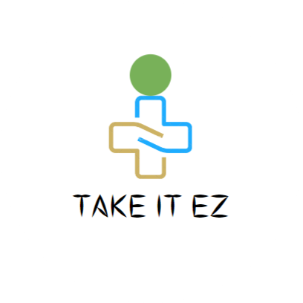
TAKE IT EZ
THE DOCTOR FINDING APP

Slide 2
ABSTRACT
“TAKE IT EZ” is an application that makes ease of life , It helps the people to find doctors for their health related problems.
It provides a user friendly experience, as well as it will provide information such as doctor’s name, clinic name and location details, contact number and doctor’s specialization through our host server.

Slide 3

HOW DOES IT WORK…..?
FRONT END :
Kotlin is a cross-platform, statically typed, general-purpose programming language with type inference.
Kotlin is designed to interoperate fully with Java, and the JVM version of Kotlin's standard library depends on the Java Class Library, but type inference allows its syntax to be more concise.

Slide 4

HOW DOES IT WORK…..?
BACK END :
SQLite is a database engine written in the C programming language and maintained by Hwaci. It is not a standalone app; rather, it is a library that software developers embed in their apps. As such, it belongs to the family of embedded databases.
SQLite is an open-source, zero-configuration, self-contained, stand-alone, transaction relational database engine designed to be embedded into an application.

Slide 5
THANK YOU !

